Slide 1
Credit Card Comparison

Slide 2
Instructions:
Research 10 Credit Cards -go to www.nerdwallet.com/credit-cards
Choose one credit card from each category
Complete the information
Make into PDF
Upload to your website

Slide 3
CITI THANK YOU PREMIER CARD
This is a REWARDS CARD
Annual Fee: you pay $95 a year, but the first year is free
Rewards: 1 point per dollar
APR: Variable %14-23
Introductory APR: N/A
BALANCE TRANSFER: N/A
Why would you want this card?
This card offers you good points for making purchases. It’s a good rewards card. However, there is a fee and the interest rate is high.

Slide 4
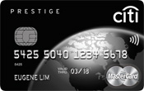
Citi Thank You® Preferred Card for College Students
Students CARD
Annual fees $o
Reward 1 point per dollar
APR N/A
Introductory APR N/A
BALANCE TRANSFER N/A

Slide 5
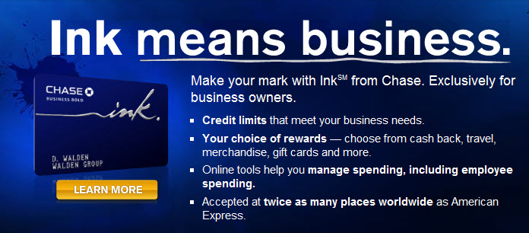
Ink Cash® Business Credit Card
Business Credit Cards
ANNUAL FEES $0
REWARDS 5% CASH BACK
APR
Introductory APR: 12 months on purchases and balance transfers.

Slide 6
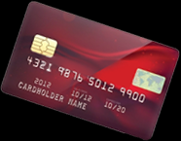
Discover it®-Double cash back your first year
Cash Back Credit Cards
ANNUAL FEES $0
REWARD 1.0%
APR 10.99%– 22.99%
INTRODUCTROY APR 0% intro APR on balance transfers for 18 months—

Slide 7
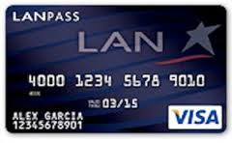
US Bank LANPASS Visa Secured
Secured Credit Cards
Annual fees $25
Reward 1.0%
APR N/A
INTRODUCTROY APR N/A
BALANCE TRANSFER N/A

Slide 8
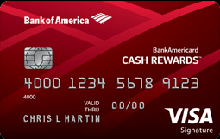
Bank Americard Cash Rewards™ Credit Card
Rewards Credit Cards
Annual fees $0
Reward 1.0%
APR 12.99% - 22.99%
0% Introductory APR for 12 billing cycles for purchases and for any balance transfers

